Slide 1
Used Car Price Prediction Model
Kyle Chou, Ricky Salazar, Jaewon Jeong

Slide 2
Table of contents
01
02
03
Our Question
Cleaned Data
Results

Slide 3
01
Our Question

Slide 4
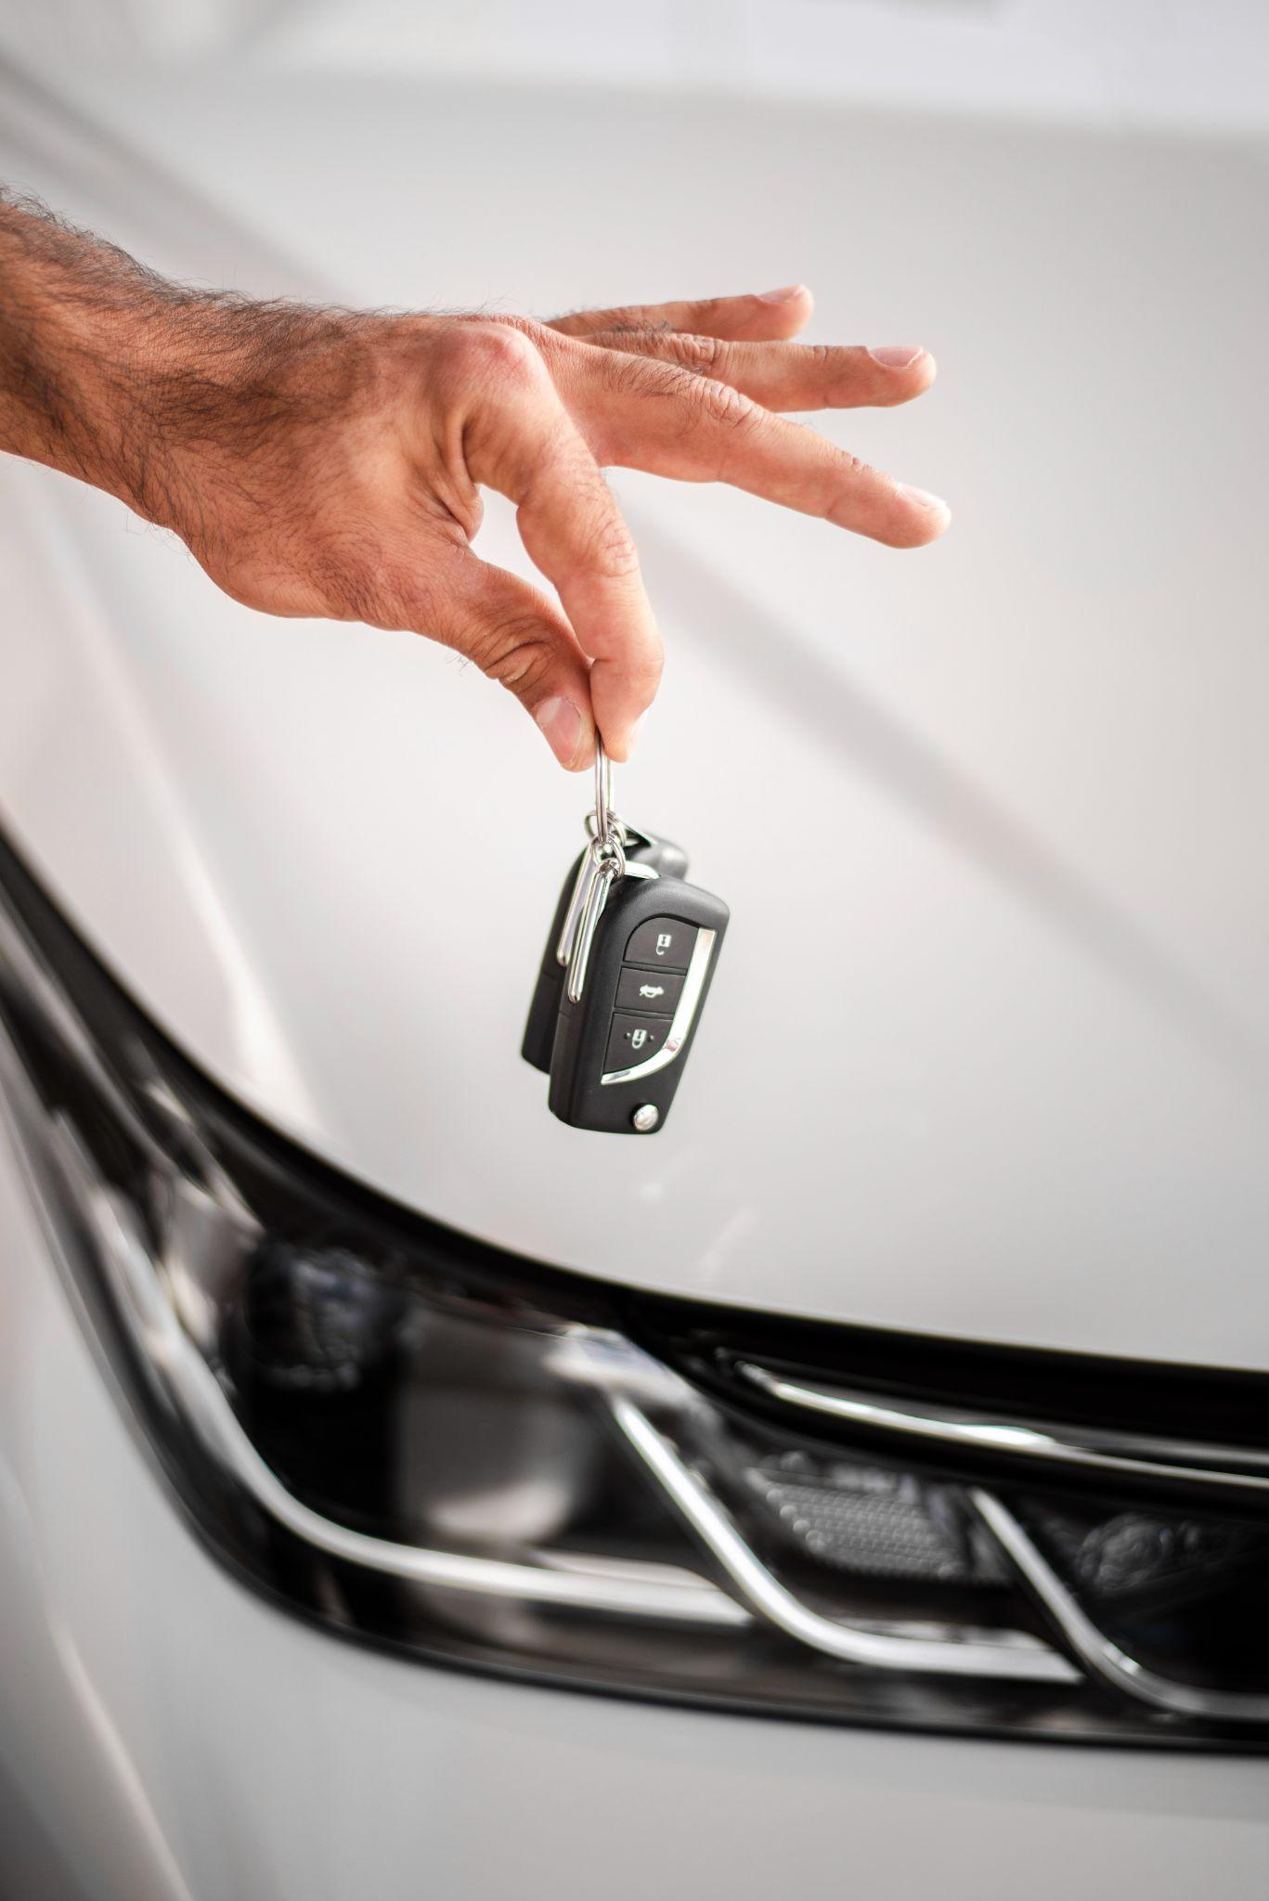
Can we predict the price for used cars sold in the US?
Kaggle Dataset (US Sales Cars Dataset) scraped from cars.com:
https://www.kaggle.com/datasets/juanmerinobermejo/us-sales-cars-dataset

Slide 5
Our Data Model
Categories: Brand, Model, Mileage, Year, Status (new,used, or certified pre-owned), Dealer, Price
Determined predictive power via Random Forest and Gradient Boosting Regression.

Slide 6
02
Cleaned Data

Slide 7
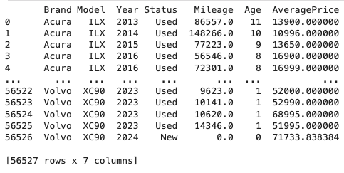

Slide 8
03
Results

Slide 9
